Slide 1
Build Time Reduction Using ElectricAccelerator at Emulex
Emulex SCM Team
Copyright © 2014 Emulex. All rights reserved. Emulex and the Emulex logo are trademarks of Emulex.
EMULEX CONFIDENTIAL
Revision 1.0

Slide 2
Presentation Overview
The purpose of this presentation is to describe how Emulex achieved Software Build time reduction by implementing Electric Cloud ElectricAccelerator (EA).
This presentation will provide in more detail information about:
Emulex Corporation
Emulex Software build time with EA
Solutions implemented to improve build time
Challenges faced with implementation

Slide 3
Presenting Speakers
Sivakumar Raju
Senior Manager Engineering
Arjun Shantharam
Principal Engineer

Slide 4



Emulex Market Share Leadership
Fibre Channel¹
Ethernet¹
Network Recording²
#2 in total FC revenue
#1 in 16GFC revenue
#1 in Total FCoE
#2 in Total 10GbE Revenue
#2 in 10Gb Network Recording
#1 in 40/100 Network Recording
Sources:¹ Crehan Research Server-class Adapter and LOM Market Share Report 1Q2014, May 2014
² Frost & Sullivan Network Recording Market Report, June 2013

Slide 5























Emulex Market Share Leadership
Net App

Slide 6
Problem Description
Emulex Corporation experienced increased build time and reduced number of build deliverables to internal and external customers.
Increased build time and reduced amount of deliverables impacted the following areas:
Time to delivery
Time to test
Time available for development
Emulex must provide driver support for OS distributions and different architectures for multiple (8-11) OEMs.
Each OS version has sub-versions and all must be supported (i.e., 32-bit, 64-bit, rh5u8, rh6u3, rh7, oel5u8, etc.).
A physical machine for each version cannot be maintained nor can each machine be duplicated for multiple Release Train (RT) builds.
Emulex had to adopt the Linux chroots model to install OSs and increase number of distributions needed to support multiple OEMs.

Slide 7
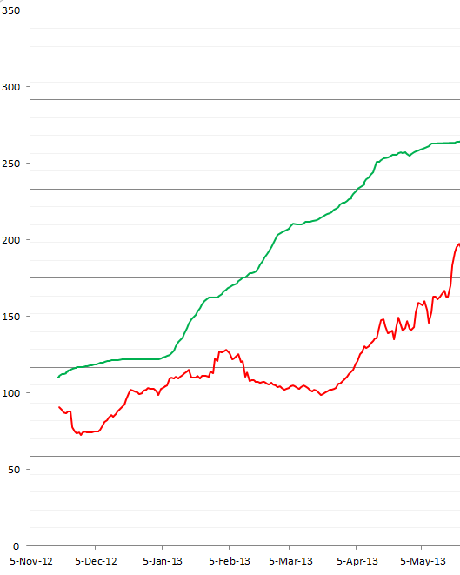
Graph Before Build-Time Reduction
This graph illustrates how Build time was impacted when encountering time and deliverable issues.
Total Component Count
Total Build Time

Slide 8
Problem Description (Cont.)
The complexity with Emulex builds are two-fold.
Software builds must be provided for the following variances:
Multiple ASICs
Lancer, Skyhawk, Pilot, BE2, BE3
Multiple OS distributions
Red Hat, SUSE, Citrix, Oracle, Solaris, etc.
Multiple Architecture
32-bit, 64-bit, PPC, Sparc, etc.
Custom packaging for OEMs
Need to check out hundreds of source repositories
Must deal with increased build time.
Initially there were about 70 different components to build and as we integrated various ASIC drivers and Emulex software into a unified Build System, we ended up with more than 300 components. This increased our build time from 6 hours to 18 hours.

Slide 9
Solutions
To reduce the build time and to help speed up concurrent builds for faster delivery, we tried two options:
Introduced home-grown parallelization
Evaluated third-party tool: EA
Using the home-grown parallelization application:
Reduced build time about 30% from 18 hours to 15 hours. Though it helped a little, this reduction was still not efficient enough.
Using EA:
Evaluated two components: Firmware and Driver
Firmware build time was reduced from 1 hour to 30 minutes
Driver build time was reduced from 45 minutes to 15 minutes
Since the evaluation of the sample components was successful, it gave us the confidence that EA would work in a full-scale implementation of Emulex software builds.

Slide 10
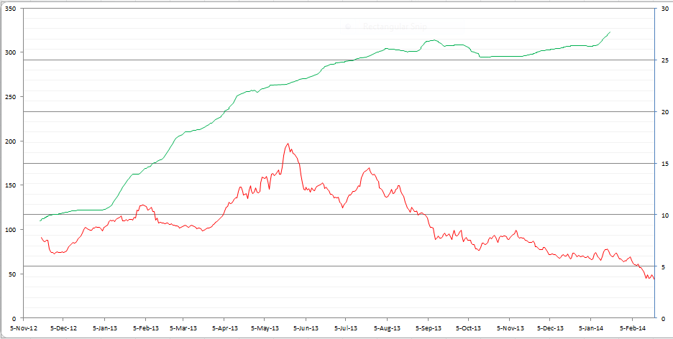
Graph After Build-Time Reduction
This graph illustrates how Build time was impacted after EA implementation.
Total Component Count
EA Implementation begins
After EA implementation, the Build Time is coming down even while the Component count is going up.
Total Build Time

Slide 11
EA Implementation Strategy at Emulex
The Emulex software build process compiles boot, firmware, drivers, applications, installers, and packages as part of the automated build process.
EA was implemented at Emulex using the following 3-fold methodology:
First, integrated components which were considered to be trivial to the EA process but could be accelerated using EA.
Second, integrated components which were taking more time to build and were more complex to implement.
Third, integrated every component and accepted whatever acceleration we could achieve.

Slide 12
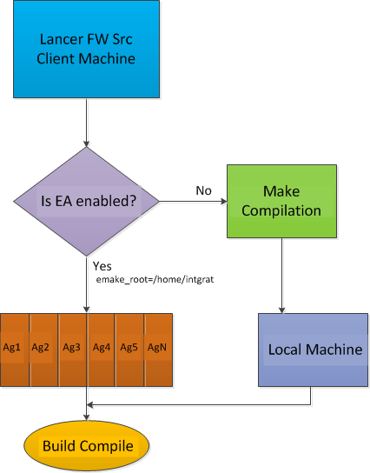
Architecture – Lancer Implementation of EA

Slide 13
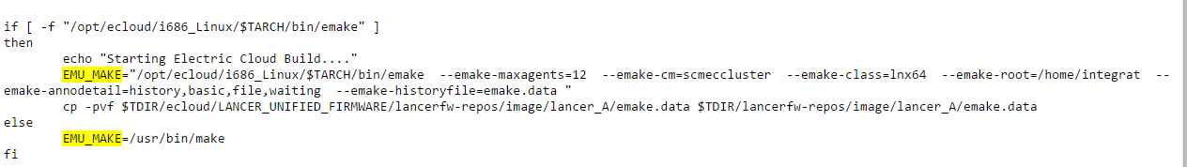
EA implementation for Lancer Firmware
This section provides an overview of the Emulex implementation of EA for the following components:
Lancer FW
OneConnect Manager (OCM)
Packaging
Lancer Firmware Implementation Overview:
Before implementing EA, Lancer Firmware build time took 45 minutes.
After implementing EA, build time was reduced to 19 minutes.
The following describes how we implemented EA:
Top level build script modified to invoke emake instead of make
Script Example:

Slide 14
EA implementation for Lancer Firmware – Challenges Faced
The following were the challenges faced during EA implementation:
Maxagents
Problem: For Lancer firmware there are nested Makefiles, so emake was unable to process all the Makefile’s at a time.
Solution: Number of EA agents to compile the files were restricted to 12
Development builds took a longer time to compile
Problem: In the development environment the lancer firmware compilation was taking a longer time than usual after migrating to EA.
Solution: In the developer build the gnumake had the jobs option enabled, which was removed after EA migration. This flag was enabled back for developer build only.
License Issue
Problem: The Lancer FW build requires a specific third party license and the number of licenses are limited. So when EA agents were enabled for the build, the license server could not find enough licenses and the build crashed looking for more licenses.
Solution: The number of EA agents were restricted to 12.

Slide 15
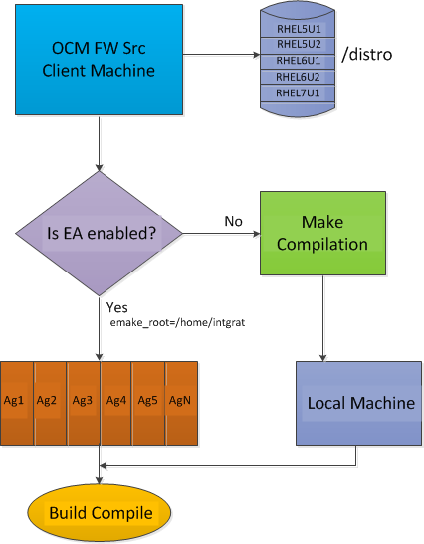
Architecture – OCM Implementation of EA

Slide 16
EA implementation for OCM
OCM Implementation Overview:
Before implementing EA, OCM build time took 30 – 35 minutes.
After implementing EA, build time was reduced to 11 minutes.
The following describes how we implemented EA:
Complexities
Drivers/OCM are built for different OS distributions (i.e., Redhat, Oracle Linux, SUSE, etc.) and for different versions
For each OS distribution different versions are built – rh5u8, rh6u3, rh6u6, rh7, oel5u8, oel6u3, sl10sp3, sl11sp1, sl12
All the above versions are needed in both 32bit and 64bit
Chroot’s are used to build Drivers/OCM for these different OS distributions

Slide 17
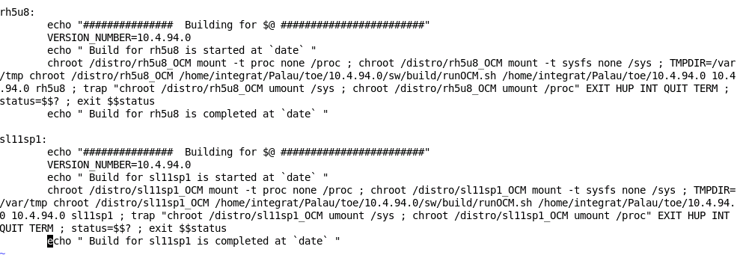
EA implementation for OCM (Cont.)
Cont.
EA for OCM
We created the Makefile on-the-fly with the list of distributions that OCM needed to be built on.
We called the Makefile with emake.
Example of script:

Slide 18
EA implementation for OCM – Challenges Faced
The following were the challenges faced during EA implementation:
EFSroot busy
Problem: Since we use Chroots at Emulex to build OCM applications for different OS distributions, the agents died after we ran a build with the error message: “EFSroot busy”. The only way to bring the agents back online was to restart the agent machine.
Solution: Electric Cloud determined the problem to be with the EFS file system, which was unable to unmount the chroot file system that it mounts while processing the build. Electric Cloud included the fix in their code and delivered a new release.
Hard link Errors
Problem: We created hard links and copied them into chroots. The inode was same for the hard link files. Because of this, EA threw conflicts and errors and the same distro was compiling two or three times. This expended a great deal of time.
Solution: We copied the source files individually to the chroots.

Slide 19
Package Build Optimization Using EA
The Package Build includes the creation of multiple software packages the size of 2Gb or more.
Package Build Optimization Overview:
Before implementing EA, package build time took 15 minutes per package.
After implementing EA, build time was reduced to 30 minutes for the entire set of packages.
These compressed packages (zip files) contains a complete set of software required for an OEM and each OEM has their own definition of the package content.
The problems encountered with this process were:
The serial build process consumed 15 minutes per package to build, taking 2 hours or more to build depending on the number of OEMs.
Finding an efficient way to build multiple packages
Large time consumption

Slide 20
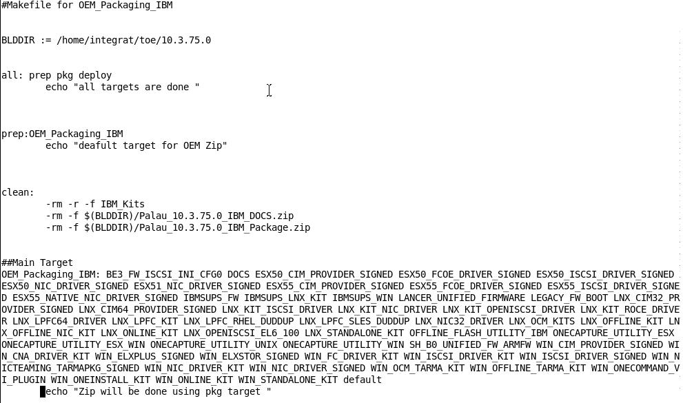
Package Build Optimization Using EA (Cont.)
The Solution was to:
Moved the build process to a Linux machine
Used a Linux symlink to create a structure for multiple OEMs
A makefile was created for each OEM
EA was called and ran all the builds in parallel
Example of Script:

Slide 21
Accomplishments-to-Date
Continual Effort to achieve more reduction of build time.
Currently, we have only integrated 40% of the components into EA
We are continuously working on integrating the rest of the components into EA.
Day 1 OS Support
Emulex is able to deliver software updates on the same day any Microsoft Windows or Linux distributions (i.e., Red Hat, SuSe) are available on their vendor site for public download.
With EA implementation we have been able to accomplish:
A significant reduction in software build time
A quicker delivery of software packages to internal/external customers
An impressive increase in software builds; going from one build per week to producing 15 builds a day.

Slide 22
Q & A

